Slide 1


Loan Default Prediction Capstone Project
Practical Data Science/Classification
Presenter: Andrey Drozdov

Slide 2

Agenda
Key takeaways
Overview of the problem
Approach for the solution
Key findings & insights
Recommendations & next steps
Solution implementation benefits

Slide 3
Key takeaways
Goal: to improve bank's loan approval process and reduce current 20% default rate
Data science and machine learning models used to construct a predictive credit scoring model
Random Forest Classifier with Hyperparameter Tuning

Slide 4
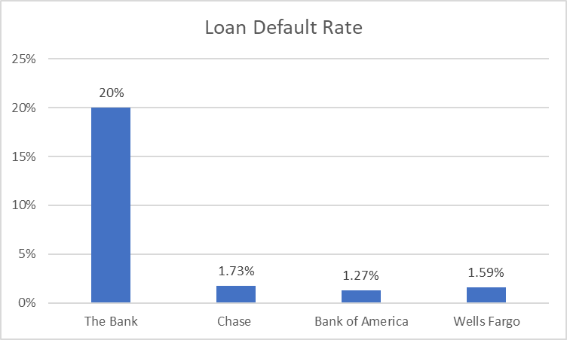
Overview of the problem
Home Equity approval process is too cumbersome
Regulatory risk is high = current model is prone to biases
5,960 applicants with 13 unique data points analyzed
20% of loans defaulted

Slide 5


Approach for the solution
Build classification model:
Predict default
Identify important features for loan approval
Model to be easily interpreted and justify loan denials in compliance with ECOA
Model to reduce default rate to industry standard of 3%

Slide 6

Key Findings & Insights
Dataset Overview:
5,960 applicants' data with 13 values during the approval process.
20% default rate (industry standard: 3-5%).
DEBTINC has the highest missing values (21%), comparable to the default rate.
Lack of DEBTINC data indicates a gap in capturing crucial information for loan approval.
Loan and Debt Analysis:
Loans range from $1,100 to $89,900, skewed to smaller amounts.
DEBTINC ranges from 0.52% to 203%, right-skewed with outliers.
Number of delinquent credit lines, major derogatory reports, and loan reasons are varied.
Bivariate Analysis:
No significant differences in loan amounts, mortgage due, collateral value, or job tenure between defaulters and non-defaulters.
Slightly higher default proportion for home improvement loan applicants.

Slide 7
Key Findings & Insights: Model Evaluation
Logistic Regression: 1. not capable to predict loan defaults = 4% to 5% correctly id’d
2. Important features: DEBTINC, DELINQ, CLNO, NINQ, DEROG
Decision Tree: 1. 36% of defaulted loans missed (64% recall on test)
2. Features: Missing DEBTINC, DEBTINC, CLAGE, LOAN, VALUE
Decision Tree - Hyperparameter Tuning: 1. 35% of defaulted loans missed (65% recall)
2. Features: Missing DEBTINC, DEBTINC, DELINQ, CLAGE
 | Model | Train_Accuracy | Test_Accuracy | Train_Recall | Test_Recall | Train_Precision | Test_Precision
1 | Logistic Regression | 0.80 | 0.82 | 0.05 | 0.04 | 0.8 | 0.69
2 | Decision Tree | 1.00 | 0.87 | 1.00 | 0.64 | 1.00 | 0.71
3 | Decision Tree Tuned | 0.89 | 0.87 | 0.69 | 0.65 | 0.74 | 0.69
4 | Random Forest | 1.00 | 0.90 | 1.00 | 0.67 | 1.00 | 0.82
5 | Random Forest Tuned | 0.97 | 0.89 | 0.99 | 0.76 | 0.87 | 0.72

Slide 8
Key Findings & Insights: Model Evaluation cont.
Random Forest Classifier: a) improved recall and accuracy by 3% vs Decision Tree
b) Features: Missing DEBTINC, DEBTINC, CLAGE, DELINQ
Random Forest Classifier with Hyperparameter Tuning:
a) Improved accuracy, recall, and precision
b) Features: Missing DEBTINC, DEBTINC, CLAGE, DELINQ
c) enhanced generalization capabilities and improved test accuracy, despite a slightly lower training accuracy.
 | Model | Train_Accuracy | Test_Accuracy | Train_Recall | Test_Recall | Train_Precision | Test_Precision
1 | Logistic Regression | 0.80 | 0.82 | 0.05 | 0.04 | 0.8 | 0.69
2 | Decision Tree | 1.00 | 0.87 | 1.00 | 0.64 | 1.00 | 0.71
3 | Decision Tree Tuned | 0.89 | 0.87 | 0.69 | 0.65 | 0.74 | 0.69
4 | Random Forest | 1.00 | 0.90 | 1.00 | 0.67 | 1.00 | 0.82
5 | Random Forest Tuned | 0.97 | 0.89 | 0.99 | 0.76 | 0.87 | 0.72

Slide 9



Recommendations & next steps
Improve loan application system
Implement Random Forest Classifier with Hyperparameter Tuning Model
Automate loan approval process
Monitor performance of the model

Slide 10


Solution implementation benefits
Random Forest Tuned:
Easy to interpret = reduced regulatory risk
Model enables the identification of predicted variables
Resilience to outliers, non-linearity, and multicollinearity = no biased impact to loan decision
High accuracy and precision scores insures better identification of customers that would pay loans back
Decreased loan repurchase/default = increased profitability for the bank
Streamlined and improved loan approval process
2. Implement hard stops for missing data
Complete data Improves model output

Slide 11
Thank you

Slide 12
Questions?

